Slide 1
EE 5323 Phase 2 Report 16 bit Han-Carlson Adder
Cole Nielsen

Slide 2
Materials/File Access
My files are accessible on /home/class/niels538/cds_ncsu45/5323_proj (should be readable)
Open the above mentioned directory as a library, and the top level design for the schematic is a cell called “adder”
The “5323_proj” directory is also included in this submission
The parasitic netlist for the layout, DRC and LVS outputs are included in the root of the folder this presentation is in (not going to put them in slides for readability).

Slide 3
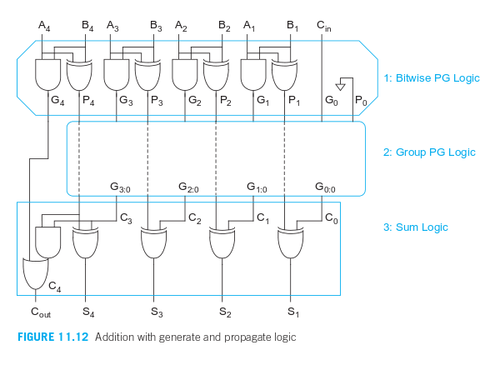
Circuit Design – Han-Carlson Adder
General look ahead adder type circuit with PG logic (from course textbook)
In order to design a fast adder, we use a look ahead topology that utilizes calculation of Generate and Propagates from each input pair and a group PG logic network in order to determine the sum of the inputs. The PG logic determines the carry in for every bit, and when XORed with the propagate for every input pair we get the respective sum bit that is part of the full 16 bit sum. This type of circuit is much faster than a ripple adder as the time to propagate the Group PG logic is typically much faster as it takes only a few stages to calculate Generate signals.
The image to the left shows the topology used, from the textbook (Weste and Harris)

Slide 4
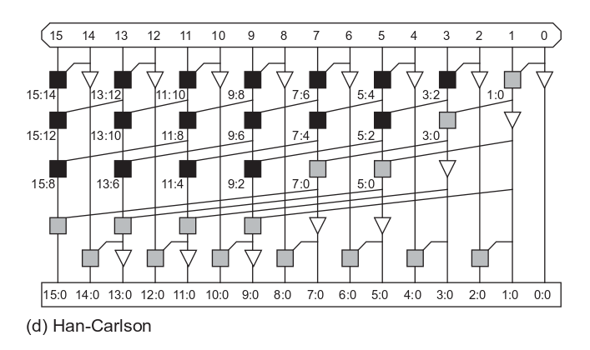
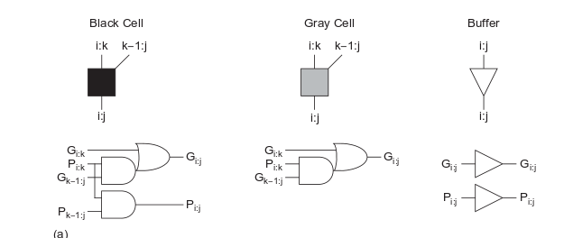
Han-Carlson Adder
For this design, I used a Han-Carlson Tree adder design for the Generate signal calculation. This design works by calculating the initial Propagate/generate terms, and then using a network to calculate find the output Generate bits by combining pairs of group generates in order to find the group generate for bit n:0, where n is the generate signal being created.
The Han-Carlson is a trade off between the Brent-Kung and Kogge stone tree adders, compromising between amount of logic and speed in order to get an overall good design.

Slide 5
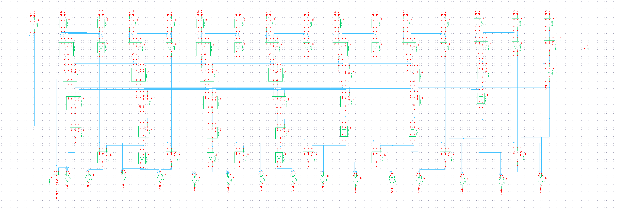
Circuit Implemtation Schematic
This is the full schematic of my design. The init_PG blocks calculate prefixes, PG_buffer is the buffer shown on the last slides design, the Group_PG blocks are the black cells on the last slide, and the Group_G are the gray cells on the last slide

Slide 6
Design Optimization/Changes from Phase 1
I changed my previous design by reducing the generate logic previous used in the group generate logic to a single 3 – input gate. Overall this reduced the design by approximately 64 transistors
I also used NAND logic and a minimal XOR implementation to make the design as small and fast as possible.

Slide 7
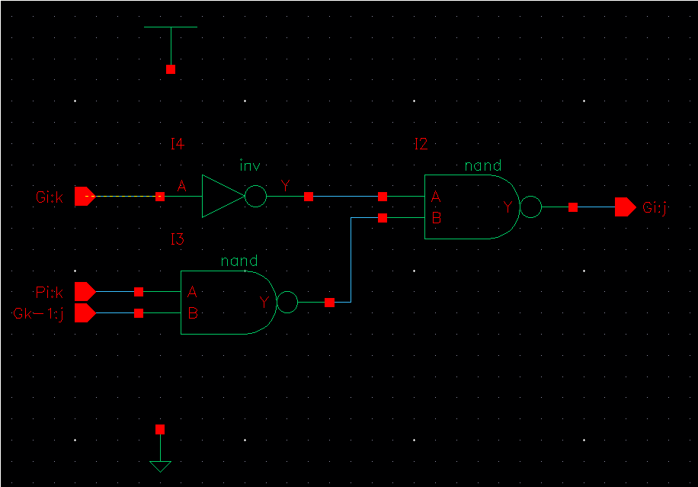
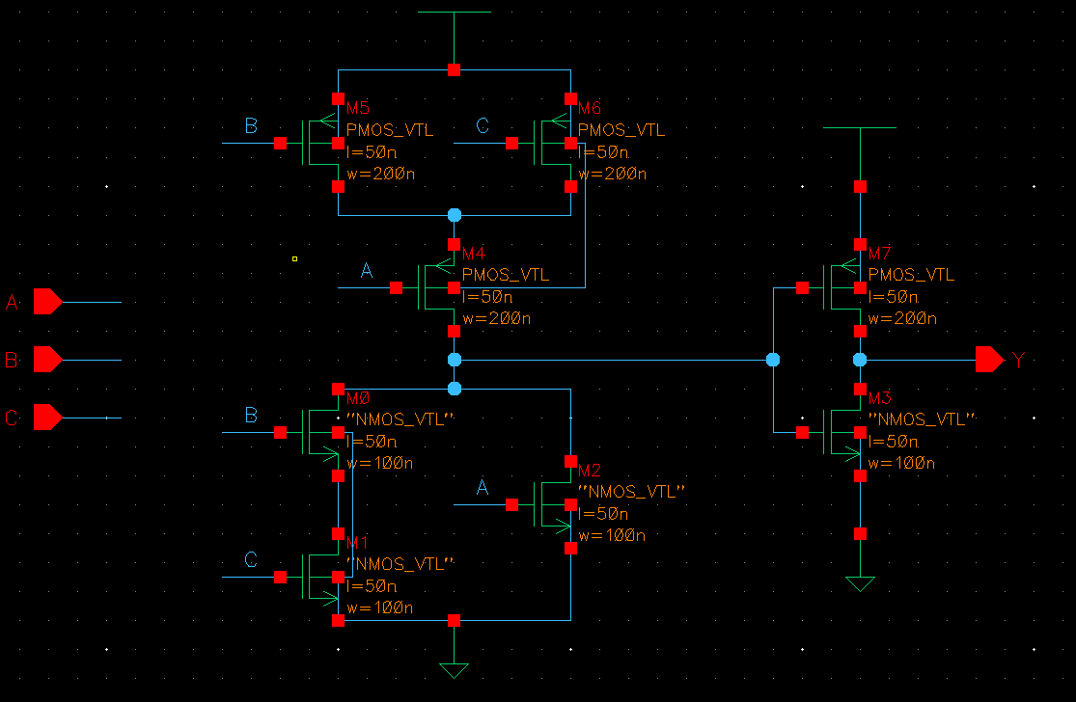
Group Generate Logic Modification
Old Group Generate Logic (10 trans.)
New logic (8 transistors)
The remaining logic is the same as Phase 1 so I won’t re-explain it.

Slide 8
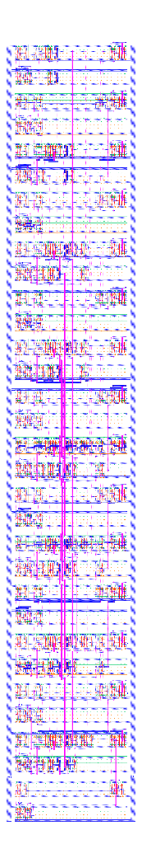
Layout
The image to the left is the full adder layout. Zoom into the image to see more detail as it is quite large/detailed.
The total area is 725um^2 (10.25x70.725um) not including the side power connections
With power connections it is 760um^2 (11.75x70.725um)

Slide 9
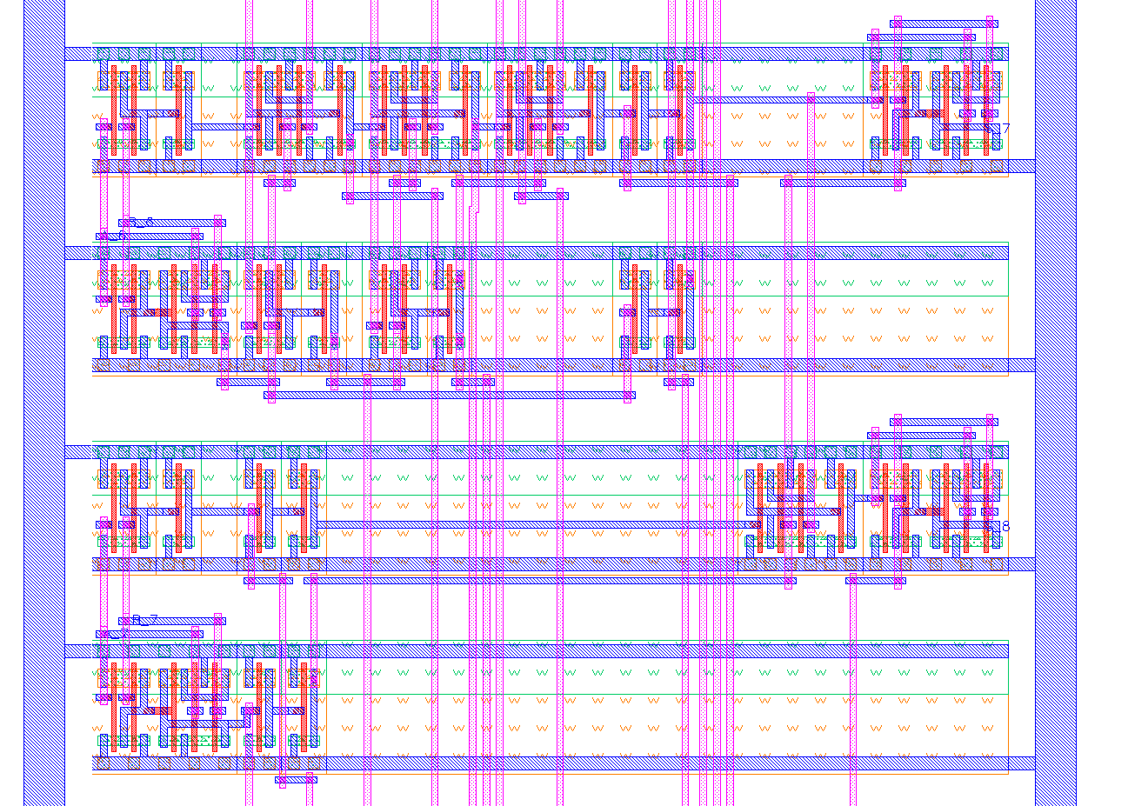
Layout details
The zoomed in view of part of the adder shows the layout implementation. I layed it out using two rows per output bit, one for calculation group generates and the other for group propagates. Each row is implemented with a continuous VDD and GND rails, as well as continuous wells, which allows for a compact design vertically. 5 wires of space was left between rows. The length of the adder was determined by the longest logic row of the design. Logic in the rows with less logic were spaced out in a way such that routing signals was most convenient.

Slide 10
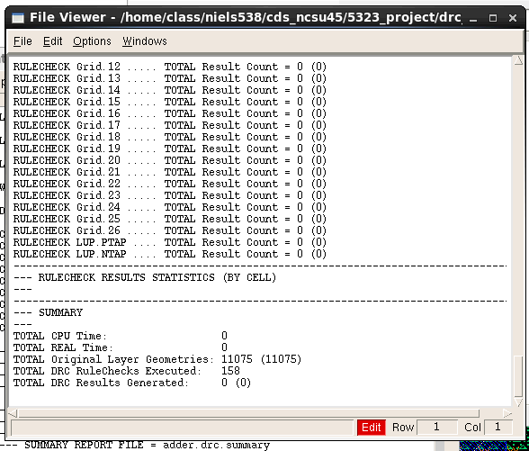
DRC
DRC was completed with no errors (no DRC results). Check the DRC files in the root of the folder this assignment was delivered in.

Slide 11
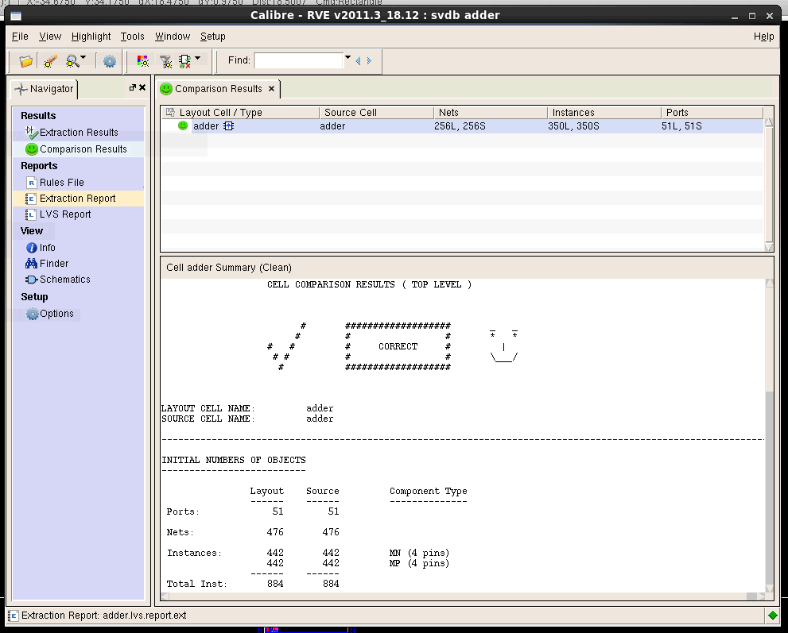
LVS
Similarly the LVS for the design passed with no issues. See the LVS output files in the root of the direction this slide was submitted in.

Slide 12
Parasitic model
See PEX_netlist folder root of assignment directory for the parasitic model (adder16b.sp).

